Slide 1
Lesson 09: External Libraries

Slide 2
Attendance

Slide 3
What are libraries?

Slide 4
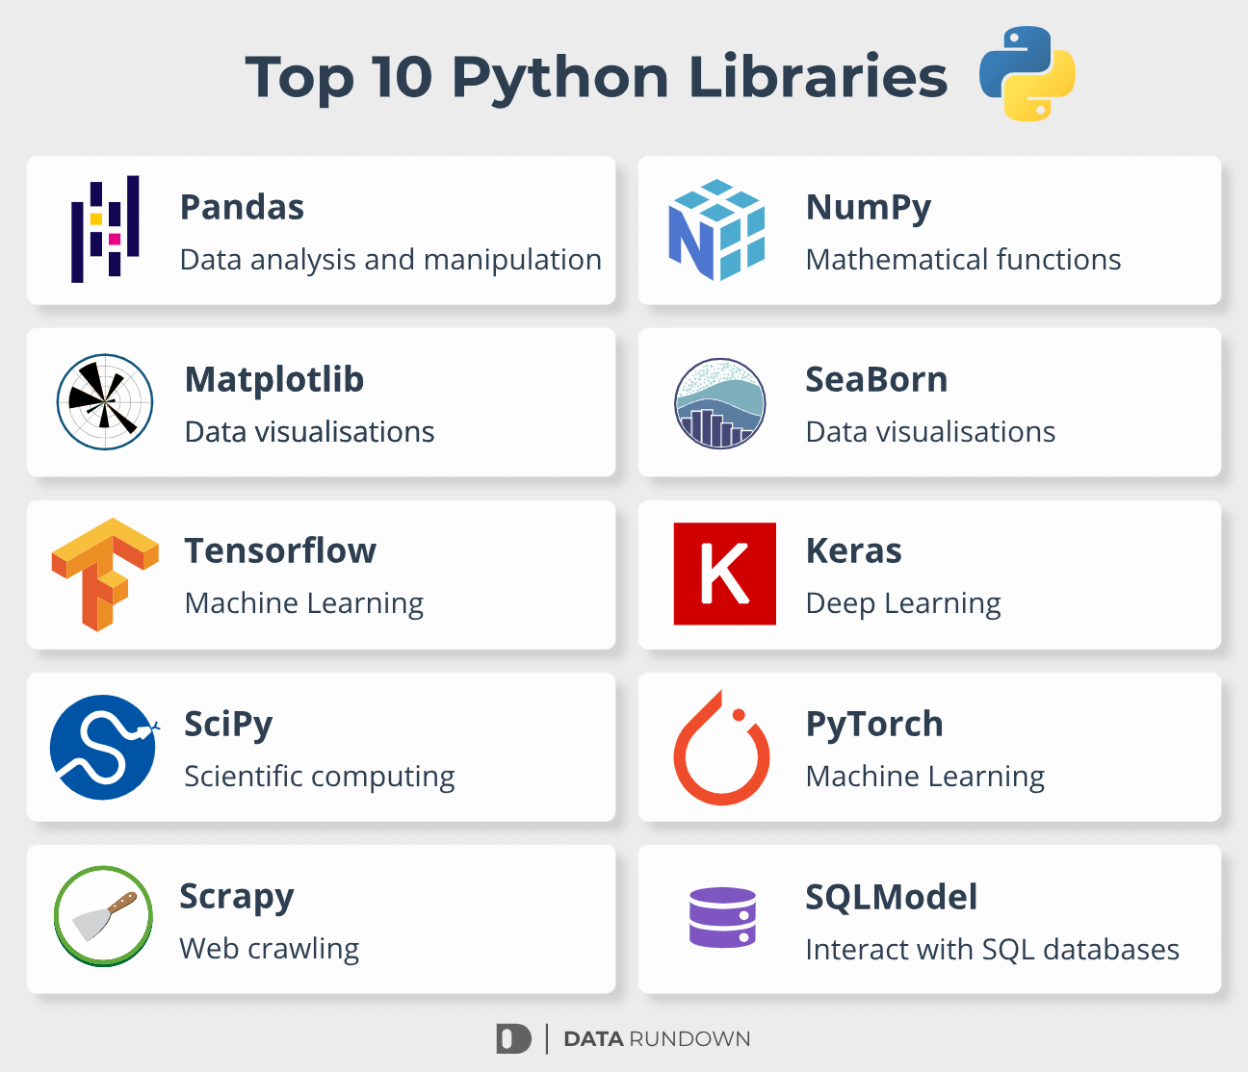
Modules/Packages
They are collections of pre-written code that offer functions, classes or methods that are not available in python’s standard library.
Standard python library:
https://docs.python.org/3/library/index.html
[Internal to python, don’t need to install]
Can be used for things like:
Plotting
Arithmetic/mathematics
Data structuring
Deep-learning/AI

Slide 5
Why do we use them?

Slide 6
Why use libraries?
Efficiency:
Coders/programmers are lazy! Why write something, when someone has already done it for you and documented it!
Support/updates:
Some packages offer a lot of support in the form of forums, troubleshooting guides and continuous updates
Standardisation:
Can help standardise the approach to code development in different areas: e.g. deep learning models, plotting/data visualisation

Slide 7
Let’s give it a go
[Internal libraries]

Slide 8
Internal libraries
Standard python library:
https://docs.python.org/3/library/index.html
[Internal to python, don’t need to install]
Statistics module
Let’s have a go at importing statistics
Choose a module within statistics and find it in the source code
Use the module (e.g. median)
Pick your own python standard library and import it

Slide 9
Let’s try another package
Plotly!

Slide 10

Plotly
Plotly is an Open Source graphing library for creating high quality and interactive graphs and charts
This is an external library so we need to install it. For that we use pip!
Try this in your command prompt or powershell terminal:
pip install plotly

Slide 11
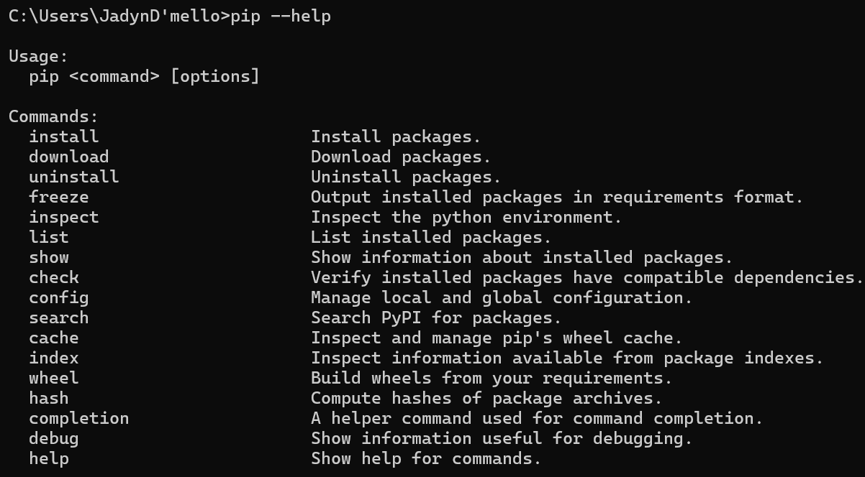
Using pip
Pip is a python package manager. It helps us upgrade, install, remove packages and lots more.
For a full list of commands, try type ‘pip --help’ into your command prompt

Slide 12
Common Errors

Slide 13
List of common debugging solutions for pip
Make sure you are using command prompt or Powershell to install the package
Try ‘pip --help’ : If this works, you know that the pip command works, and the issue is likely with the name of the package you are installing
Try ‘py -m pip install…’ or ‘python -m pip install…’
[Mainly windows]: Ensure ‘pip.exe’ is on PATH (check environment variables)
E.g. my PATH has : C:\Users\Jadyn\AppData\Local\Programs\Python\Python311\Scripts

Slide 14
Plotting example…
# x and y given as array_like objects
import plotly.express as px
fig = px.scatter(x=[0, 1, 2, 3, 4], y=[0, 1, 4, 9, 16])
fig.show()
Try the Gapminder dataset:
Source: https://www.gapminder.org/tools/#$chart-type=bubbles&url=v2
# load built-in gapminder dataset from plotly
gapminder = px.data.gapminder()
# df = px.data.gapminder().query("continent == 'Europe'")
# fig2 = px.line(df, x='year', y='lifeExp', color='country')
# fig2.show()

Slide 15
Exercise
Plot your own data!!
Ideas:
Manually write some data into 2 lists such as x and y
x=[0, 1, 2, 3, 4], y=[0, 1, 4, 9, 16]
Create a python function (i.e. linear function or trigonometry function,etc)
Try another plotly.express plotting function instead of ‘scatter’

Slide 16

FastAPI
‘FastAPI is a modern, fast (high-performance), web framework for building APIs with Python based on standard Python type hints’
Another external library

Slide 17
What is an API
A connection between computers or computer programs
https://www.instagram.com/reel/C9_iUKbS1d0/?igsh=MTcyNGl2N3JwYndrMQ==
APIs can be used to get data from a server or client, to then use in your own code!
…think of them as a waiter at a restaurant that takes your order and then tells the kitchen what you want. In return, you get food back from the kitchen

Slide 18
Let’s try a simple usage using a HTTP request
Install fastapi, uvicorn
Get source code from classroom and save file in a known python project directory
Run file
Go to http://127.0.0.1:8000

Slide 19
Let’s make a Weather app!
Install fastapi, uvicorn and httpx
Go to https://openweathermap.org/ and sign up for an API key
Get source code from classroom and insert API key. Save file in a known python project directory
Run file
From directory command prompt (or python shell), try:
uvicorn Weather_main:app --reload
Go to http://127.0.0.1:8000 and edit url with http://127.0.0.1:8000/weather/London for example (change city name and watch the magic happen!)

Slide 20
A taste of virtual environments…

Slide 21
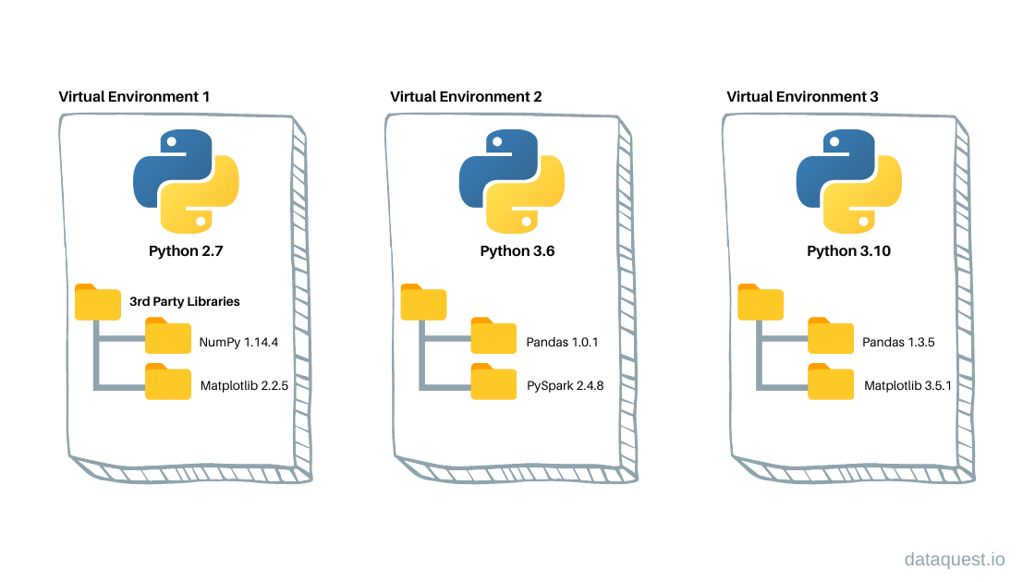
Src: https://www.dataquest.io/blog/a-complete-guide-to-python-virtual-environments/

Slide 22
Thankyou!

Slide 23
Thankyou!

